Slide 1
Iran/USA/Israel Conflict
CAT Response Overview
LMA Complex Claims Group
March/April/May 2026

Slide 2
Market Update 7
8th May 2026
Agenda/Discussion points
LMA briefing: Sanctions and Financial Crime Implications for Marine Insurance (included in deck)
Lloyd’s List Intelligence briefing 7th May (included in deck)
CAT reporting
Class specific updates as appropriate from sector group chairs
Upcoming meetings and briefings
  Market Communication from LMA Claims – w/c 11th May
Audience
LMA
    Claims, Legal and Marine
Market
    LMACC chairs and chair of Complex Claims Group
    Sector Group chairs:
    Political Violence & Terrorism
    Political Risk
    Financial Lines
    Professional Lines
    Property
    Reinsurance
    Marine
    Aviation
    Energy
    Renewables
    General Liability
    Cyber
Other
    IUA
    Lloyd’s
LMA Complex Claims Group

Slide 3
Sector Updates
8th May 2026
Marine:
  Approximately 34 vessels have been attacked and we have seen an uptick in claims activity over the last few days. We will continue to monitor and keep you updated.
  LLI briefing in appendix and JMCC Co-chair (Amy Eaves, Fidelis) notes on next few slides.
PV&T / Political Risk:
  Text
Aviation
  Nothing to report
Cyber
  Nothing to report but questions on recent losses to be discussed at next Cyber Claims Group meeting or ad-hoc meeting if necessary (Action: Nathalie Graham/Carolyn Thomas)
Energy
  Discussions on support from coordinating counsel held, primarily for indirect risks. JECG meeting 14/05 for further discussion.
Reinsurance
  Nothing to report. Next RICG meeting 20/05
Property
  Nothing to report. Next PICG International meeting 19/05
Fin Lines/Prof Lines/General Liability/Contingency
  Nothing to report

Slide 4
Marine update (May 2026) 1/4
Notes prepared by JMCC co-chair Amy Eaves
Strait of Hormuz transits collapsing
Vessel movements through the Strait of Hormuz have fallen sharply since mid‑April, reflecting escalating military action, competing blockade measures and growing reluctance by operators to transit the waterway amid heightened security and compliance risks.
Cargo-carrying transits (10,000 dwt+):
Week 16 (Apr 13–19): 78 transits
Week 17 (Apr 20–26): 47 transits
Week 18 (Apr 27–May 3): 40 transits
Represents an ~40% drop week-on-week.
Traceable traffic fell further following brief US‑led “Project Freedom” and Iranian escalation.
Only two traceable transits recorded by mid‑week following weekend escalation.
58% of last week’s transits had an Iranian nexus.
Both Iran‑linked and non‑Iran‑linked traffic have declined.
Some ADNOC oil & gas vessels have still transited.
Shadow fleet traffic trends
Traffic composition through the Strait has shifted materially since the blockade began, with a notable reduction in shadow fleet activity suggesting that enforcement measures and operational risk are constraining previously dominant non‑compliant trading patterns.
Historically, shadow fleet vessels accounted for >75% of Hormuz transits by dwt.
Since the blockade:
Shadow fleet and compliant tanker transits are now roughly equal.
Decline is driven mainly by reduced shadow fleet activity, suggesting enforcement impact.
Overall tanker transit levels remain well below historical norms.
Signs of tactical adjustments:
ADNOC offering MEG cargoes via STS in the Gulf of Oman.
ADNOC LNG carrier reappearing in Indian Ocean tracking data.
Notable escalation:

Slide 5
Marine update (May 2026) 2/4
Notes prepared by JMCC co-chair Amy Eaves
Iran asserts control over navigation
Iran has moved to formalise control over Strait of Hormuz navigation by establishing a new regulatory authority, introducing approval and tolling requirements, and declaring a maritime control zone that significantly challenges established freedom‑of‑navigation norms.
Iran established the Persian Gulf Strait Authority (PGSA):
  Requires submission of ownership, insurance, crew details and planned routes.
  Positions itself as the sole authority for approving Hormuz transits.
Announcement of a “maritime control area”:
  SE boundary: Iran → Fujairah (UAE)
  NW boundary: Qeshm Island (Iran) → Umm Al Quwain (UAE)
  Appears to overlap Omani and Emirati waters, including Fujairah approaches.
Evidence of enforcement:
  Masters near Ras al Khaimah instructed by IRGC to vacate anchorage.
Fujairah bunker disruption
Attacks on energy infrastructure at Fujairah have intensified supply pressures in one of the world’s most important bunkering hubs, amplifying fuel shortages, elevating prices and increasing cost volatility for vessels operating in or transiting the region.
Iranian missile strikes (4 May) hit an oil refinery at Fujairah.
Fujairah is a critical global bunkering hub, especially for Asia‑bound trade.
Consequences:
  Bunker availability tightened
  Prices remain elevated
  Owners and operators introducing emergency bunker surcharges
Heavy distillate inventories show drawdowns.

Slide 6
Marine update (May 2026) 3/4
Notes prepared by JMCC co-chair Amy Eaves
Singapore bunker knock-on effects
Disruption in Middle East fuel supply chains is feeding through into Asian bunkering markets, with sharply higher prices in Singapore prompting fuel blending practices that are now giving rise to vessel performance and machinery reliability issues.
Strait disruption has pushed Singapore bunker prices sharply higher.
While inventories remain stable:
  Sellers have begun blending fuels with cheap components (e.g. Estonian shale oil).
Operational consequences:
  Vessels bunkering in April now reporting sludging and fuel pump failures.
Container shipping network disruption
Container carriers have been forced into rapid network reconfiguration as access to the Strait of Hormuz becomes increasingly constrained, leaving vessels trapped within the Gulf and accelerating the shift towards alternative hubs and longer routing options.
~40 container vessels owned or chartered by major carriers are stuck in the MEG.
Carriers rapidly redesigning networks:
  Using Mediterranean ports, Jeddah, Khor Fakkan, Salalah as alternatives.
  Leveraging port investments (e.g. CMA CGM at Khalifa Port).
Numerous new or adjusted services launched by MSC, Maersk, CMA CGM, Gemini, CUL, etc.
Increased reliance on Suez and Cape routings, with added cost and delay.

Slide 7
Marine update (May 2026) 4/4
Notes prepared by JMCC co-chair Amy Eaves
Market impact
Rising freight rates, surcharges and bunker costs are beginning to crystallise across Middle East‑focused container trades, with early signs that prolonged disruption could place disproportionate strain on regional carriers and feed into financial results later in 2026.
Freight rates rising on Asia - Middle East trades (Asia - Khor Fakkan, Asia - Jeddah).
Additional surcharges and inland trucking costs where ports are inaccessible by sea.
Higher bunker prices amplifying operating cost pressure.
Broader impacts:
  Asia - Europe and transpacific rates elevated but manageable.
  Early financials from large liners show limited impact so far, with effects expected in Q2 2026.
  Regional operators under strain – collapse of Sea Lead Shipping highlights fragility of Gulf/Red Sea trades.
Overall implications for the maritime sector
Legal, operational and insurance risk levels around Hormuz have fundamentally shifted.
Prolonged disruption risks structural rerouting of energy and container flows.
Rising costs, impaired navigation rights and security escalation likely to feed through into claims, premiums, and contractual disputes if sustained.

Slide 8
Briefings
LMA Complex Claims Group
April 2026

Slide 9




External Briefings/Intelligence
Strait of Hormuz: Sanctions and Financial Crime Implications for Marine Insurance
29th April LMA Presentation
LLI slides from
7th May briefing
(double-click icon to open)
Previous decks available on demand
Previous decks available on demand
Geo-Economics of the War in Iran
21st April Head of Claims Briefing
Skytek - Insurance Solutions
(Provided support to the LMA on Marine)
(double-click icon to open)

Slide 10
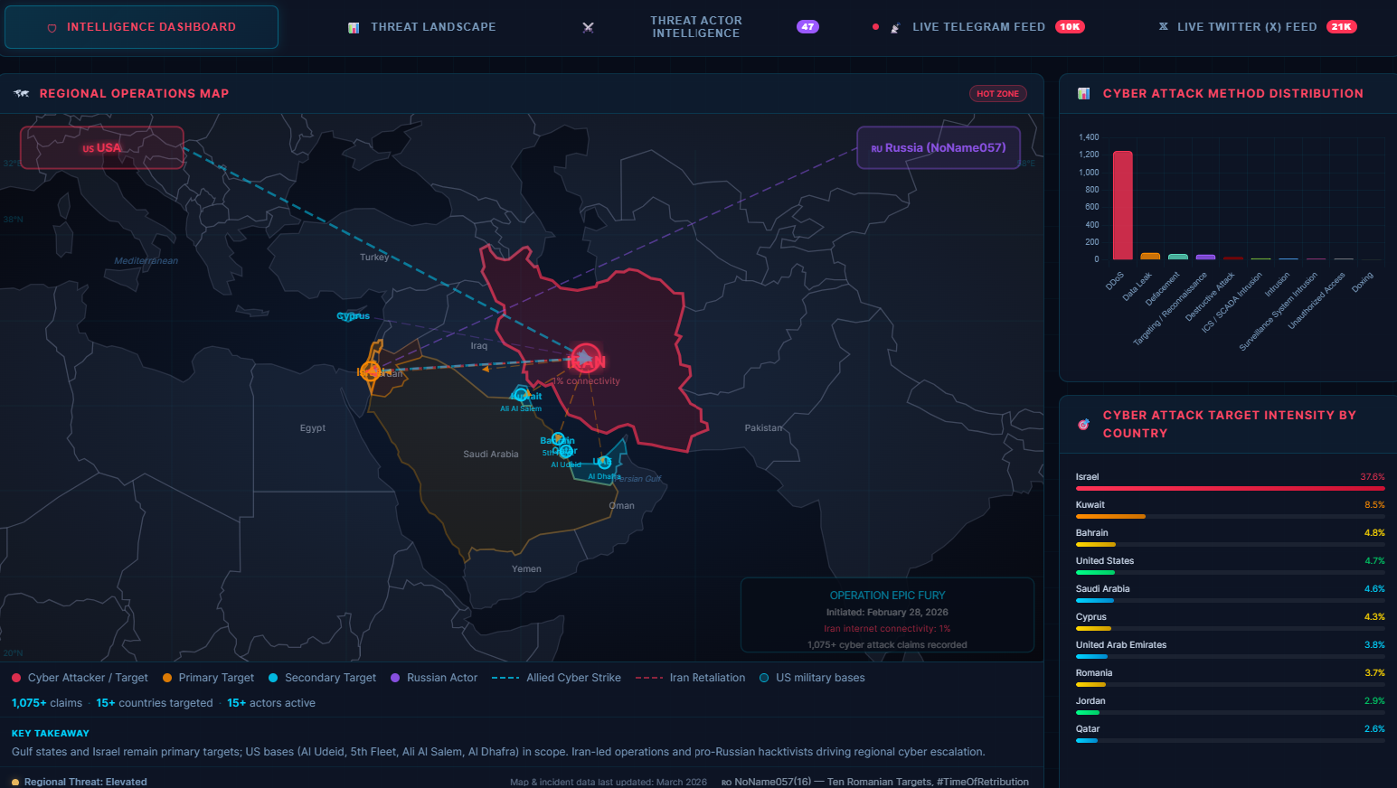
Cyber update (April 2026)
As shared by Cyber Group chair Carolyn Thomas
https://socradar.io/iran-israel-cyber-conflict-dashboard/

Slide 11
Past meetings, communications and guidance
LMA Complex Claims Group
April 2026

Slide 12
CAT Code Guidance
Political Violence & Terrorism examples
26AA – Losses directly arising from the US/Israel/Iran Conflict commencing 28th February 2026 and ongoing
(1) Iran attacking a US base in one of the Gulf states which either causes damage or, debris from ordinance causes damage along with any consequential loss that follows.
(2) Iran attacking Israel which either causes damage or, debris from ordinance causes damage along with any consequential loss that follows
(3) Iran striking a vessel in the straight of Hormuz or Vessels being stuck and incurring costs as a result of ongoing conflict
26AB - Losses indirectly arising from or in consequence of the US/Israel/Iran Conflict commencing 28th February 2026 and ongoing
(1) Hezbollah attacking Israel after 28th February which either causes damage or, debris from ordinance causes damage along with any consequential loss that follows
(2) Hezbollah or another proxy sending drones to Cyprus or other regions in the gulf which either causes damage or, debris from ordinance causes damage along with any consequential loss that follows
(3) Potential terrorist attacks in ‘retaliation’ of US/Israel attacking Iran

Slide 13
Cyber Claims Group
Opportunistic Ransomware Scenario A UK manufacturing insured suffers a ransomware attack in April 2026. The malware strain is widely used by criminal groups. No political messaging; no evidence of state direction. But for test: Would this attack have occurred but for the conflict? Yes. CAT Coding ❌ No CAT Code Reasoning On the facts known, there is nothing to suggest that this event arises from the conflict or forms part of the elevated threat environment. | Politically Themed Data Theft Scenario A US technology company suffers data exfiltration and website defacement. Attack includes slogans criticising US foreign policy towards Iran. Tooling and infrastructure is consistent with criminal actors. But for test: Would this loss have occurred absent the conflict? Likely yes. CAT Coding ✅ 26AB – Indirect Reasoning Political messaging alone does not establish direct causation but its timing suggests a connection to the conflict. Code as indirect subject to further information. | Supply‑Chain Cyber Disruption Scenario An insured’s IT service provider experiences a cyber outage. Provider operations in the Middle East are disrupted due to regional infrastructure instability. Insured suffers BI loss. But for test: Would the loss have occurred absent the conflict? Probably not in the same way or at the same time. CAT Coding ✅ 26AB – Indirect Reasoning Loss arises in consequence of conflict‑driven instability suffered by the service provider, not directly by the Insured.
State‑Linked Cyberattack on Critical Infrastructure Scenario A energy operator suffers a destructive cyberattack aligned with kinetic hostilities in the region. Credible intelligence links the attack to a state cyber unit. But for test: Would this cyber attack have occurred but for the conflict? No. CAT Coding ✅ 26AA – Direct Reasoning The cyber loss appears to arise directly from the conflict. . | Phishing / Social Engineering Scenario Employee clicks a phishing email referencing “urgent Iran sanctions updates”. Credentials are stolen and funds are misdirected as a result. But for test: Would this phishing loss have occurred absent the conflict? Yes. CAT Coding ❌ No CAT Code Reasoning Use of topical themes does not create a sufficient causal nexus. | Precautionary Shutdown and Response Costs Scenario Conscious of government messaging of heightened conflict related cyber threats, an Insured pre-emptively shuts down systems and incurs forensic costs following credible threat intelligence of an active intrusion from a potentially Iran aligned threat actor. No confirmed intrusion. But for test Would these costs have been incurred absent the conflict? No. CAT Coding ✅ 26AB – Indirect Reasoning Costs arise in consequence of the conflict‑driven threat environment.
Purpose and Status of this Guidance
This guidance sets out the recommendations of the LMA Cyber Claims Committee in respect of the allocation of cyber claims to Lloyd’s Claims Catastrophe (CAT) codes issued in respect of the US / Israel / Iran conflict. The guidance is intended to promote consistent market reporting and specifically:
does not determine coverage, policy response, or the applicability of exclusions.
does not require attribution to a state actor; and
should be applied pragmatically, based on the facts known at the time.
Applicable Lloyd’s CAT Codes
The following CAT codes have been issued by Lloyd’s:
Core Principles for Cyber Claims
When assessing CAT coding for Cyber claims, adjusters should apply the following principles:
CAT coding is an administrative classification, not a causation or liability finding.
State attribution is not required, but also should not be assumed.
Geopolitical conflict may create an elevated cyber threat environment; this alone does not make a loss “direct”.
Coding decisions should be evidence‑based, proportionate, and kept under review as information develops.
Proximate Cause – “But For” Test
To support consistent decision‑making, adjusters should apply the following “but for” test, adapted for Cyber CAT reporting:
But for the US / Israel / Iran conflict, would this cyber loss have occurred in materially the same way, at materially the same time?
This test assists in identifying proximate cause for reporting purposes only.
If the answer is “No” the loss may be directly arising from the conflict (26AA).
If the answer is “Yes”, but the conflict materially increased risk, severity, or context the loss may be indirectly arising from or in consequence of the conflict (26AB).
If the answer is “Yes” and the conflict has no meaningful causal relevance the claim should not be CAT‑coded.
Claims should not be CAT‑coded solely because:
they occur during the conflict period;
brokers or insureds label them as “Iran‑related” without evidence; or
media reporting references geopolitical tensions.
The hypothetical examples adjacent are provided to help illustrate how coding may be applied.
CAT Code | Description | Event Code
26AA | All losses directly arising from the US / Israel / Iran conflict, commencing 28 February 2026 and ongoing | 68110
26AB | All losses indirectly arising from or in consequence of the US / Israel / Iran conflict, commencing 28 February 2026 and ongoing | 68111

Slide 14
Market Update 1
2nd March 2026
Agenda/Discussion points
Initial assessment and expected impact by classes
CAT code consideration > Decision to recommend split codes by direct and indirect
Market Briefings:
  MIS: Tuesday 5pm
  MIS: Thursday 4pm
Market Comms:
  Tuesday – Heads of Claims, PICG, RICG, JMCC, PR and PV&T.
  Included CAT Code, Market Briefing details, JWR update
  Wednesday - Heads of Claims, PICG, RICG, JMCC, PR and PV&T.
  Included Velonetic comms on CAT Code, reminder on briefings
Audience
LMA
    Claims, Legal and Marine
Market
    LMACC chairs and chair of Complex Claims Group
    Sector Group chairs:
    Political Violence & Terrorism
    Political Risk
    Financial Lines
    Professional Lines
    Property
    Reinsurance
    Marine
    Aviation
    Energy
    Renewables
    General Liability
Other
    IUA
    Lloyd’s
LMA Complex Claims Group

Slide 15
Market Update 2
6th March 2026
Agenda/Discussion points
MIS Briefing Paper (see appendix)
Sanctions update (Guest: Velonetic)
CAT Code discussion
  Feedback on wording and clarity of codes
Class specific updates
Upcoming meetings and briefings
  Monday – Planned wider market update
  Tuesday – MIS Briefing
  Thursday – MIS Briefing
  Friday – Potential meeting to be discussed and if all classes are required and to extend invite to wider groups as appropriate
Audience
LMA
    Claims, Legal and Marine
Market
    LMACC chairs and chair of Complex Claims Group
    Sector Group chairs:
    Political Violence & Terrorism
    Political Risk
    Financial Lines
    Professional Lines
    Property
    Reinsurance
    Marine
    Aviation
    Energy
    Renewables
    General Liability
    Cyber
Other
    IUA
    Lloyd’s
LMA Complex Claims Group

Slide 16
Market Update 3
13th March 2026
Agenda/Discussion points
MIS Briefing Paper update (appendix)
Sanctions update (appendix)
CAT Code discussion
  Examples to be shared and discussed
Class specific updates
Upcoming meetings and briefings
  Market Communication – Follow up from LMA Claims to the market
  MIS briefings – Tuesday and Thursday
Audience
LMA
    Claims, Legal and Marine
Market
    LMACC chairs and chair of Complex Claims Group
    Sector Group chairs:
    Political Violence & Terrorism
    Political Risk
    Financial Lines
    Professional Lines
    Property
    Reinsurance
    Marine
    Aviation
    Energy
    Renewables
    General Liability
    Cyber
Other
    IUA
    Lloyd’s
LMA Complex Claims Group

Slide 17
Market Update 4
20th March 2026
Agenda/Discussion points
MIS Briefing Paper update (appendix)
LLI Briefing paper update (appendix)
CAT Code discussion
  Requests for examples have gone out wider distribution
Class specific updates
Upcoming meetings and briefings
  Market Communication – Thursday afternoons from LMA Claims Team
  MIS briefings – Thursday 26th March
  Other briefings – please let LMA Claims know if there are any other relevant briefings that should receive wider distribution.
Audience
LMA
    Claims, Legal and Marine
Market
    LMACC chairs and chair of Complex Claims Group
    Sector Group chairs:
    Political Violence & Terrorism
    Political Risk
    Financial Lines
    Professional Lines
    Property
    Reinsurance
    Marine
    Aviation
    Energy
    Renewables
    General Liability
    Cyber
Other
    IUA
    Lloyd’s
LMA Complex Claims Group

Slide 18
Market Update 5
27th March 2026
Agenda/Discussion points
MIS Briefing Paper update (appendix)
LLI Briefing paper update (appendix)
CAT Code discussion
  Requests for examples have gone out wider distribution. Cyber has been added
Class specific updates
Upcoming meetings and briefings
  Market Communication – 27th March
  MIS briefings – No further briefings scheduled
  Other briefings – N/A
  Depending on developments we will pause over Easter and reassess if there is a need for further meetings/briefings.
Audience
LMA
    Claims, Legal and Marine
Market
    LMACC chairs and chair of Complex Claims Group
    Sector Group chairs:
    Political Violence & Terrorism
    Political Risk
    Financial Lines
    Professional Lines
    Property
    Reinsurance
    Marine
    Aviation
    Energy
    Renewables
    General Liability
    Cyber
Other
    IUA
    Lloyd’s
LMA Complex Claims Group

Slide 19
Market Update 6
10th April 2026
Agenda/Discussion points
MIS Briefings stopped
LLI Briefings continue
Class specific updates
CAT reporting
Upcoming meetings and briefings
  Market Communication – Monday 13th
  MIS briefings – No further briefings scheduled
  Head of Claims briefing – April 21st
Audience
LMA
    Claims, Legal and Marine
Market
    LMACC chairs and chair of Complex Claims Group
    Sector Group chairs:
    Political Violence & Terrorism
    Political Risk
    Financial Lines
    Professional Lines
    Property
    Reinsurance
    Marine
    Aviation
    Energy
    Renewables
    General Liability
    Cyber
Other
    IUA
    Lloyd’s
LMA Complex Claims Group

Slide 20
Market Update 7
24th April 2026
Agenda/Discussion points
MIS briefing during meeting (Guest: MIS)
Lloyd’s List Intelligence briefing 23rd April (included in deck)
Head of Claims briefing 21st April – Max Hess “The Geo-Economics of the War in Iran” included in the deck
CAT reporting
Class specific updates as appropriate from sector group chairs
Upcoming meetings and briefings
  Market Communication from LMA Claims – w/c 27th April
  LMA online briefing, Wednesday 29th April 17.00 BST: Strait of Hormuz: Sanctions and Financial Crime Implications for Marine Insurance – LMA
  Lloyd’s List Intelligence, Thursday 30th April 14.00 BST: https://event.on24.com/wcc/r/5332619/F5701E3CF8C45F2F6E863F6E69842849
Audience
LMA
    Claims, Legal and Marine
Market
    LMACC chairs and chair of Complex Claims Group
    Sector Group chairs:
    Political Violence & Terrorism
    Political Risk
    Financial Lines
    Professional Lines
    Property
    Reinsurance
    Marine
    Aviation
    Energy
    Renewables
    General Liability
    Cyber
Other
    IUA
    Lloyd’s
LMA Complex Claims Group

Slide 21
Marine update (March 2026) 1/2
Notes prepared by JMCC co-chair Amy Eaves
Strait of Hormuz – Lloyd’s List Intelligence update
Overall Situation
The security environment across the Strait of Hormuz and wider Middle East Gulf has materially deteriorated since early March, with multiple direct attacks on commercial vessels, disruption to energy infrastructure, and a sharp loss of operating confidence among shipowners and charterers. While most regional ports remain operational, the risk profile for transiting Hormuz and operating within the Gulf has escalated significantly, with heightened uncertainty around vessel safety, routing, and insurance availability.
Port and Infrastructure Status
Most Middle East ports are open and operating, though several key disruptions remain:
Oman, Bahrain, UAE and Kuwait: Port operations have resumed following recent attacks and disruptions, though navigational risks persist, particularly in UAE waters where GPS jamming and spoofing continue to be reported.
Qatar: While Hamad and Doha ports are operating normally, LNG production has been halted and operations at Al Shaheen and Halul Island terminals are suspended.
Iraq: Umm Qasr port remains undamaged; however, Basra Oil Terminal and the SPM Somo Terminal have ceased operations following vessel strikes offshore.
Saudi Arabia, Jordan, Lebanon and Israel: Ports remain open and operational, subject to standard restrictions.
Overall, while port infrastructure has not collapsed, energy export terminals and offshore installations are increasingly exposed.
Attacks on Commercial Shipping
Since the 1st March 2026, multiple commercial vessels have been directly attacked in the Middle East Gulf. In addition, at least two vessels have been struck by debris, with one suspected fatality reported. These incidents underline the expanding risk envelope, extending beyond targeted vessels to those transiting or operating in proximity to affected areas.
Vessel Traffic Through the Strait of Hormuz
Traffic volumes through the Strait have reduced significantly compared with normal levels, and the composition of transiting vessels has changed:
Transits are increasingly dominated by Iran-linked vessels and shadow fleet tonnage, particularly tankers and gas carriers.
A growing proportion of voyages are being conducted with AIS switched off, with “dark” transits expected to increase further.
Nearly 60% of all recent transits show an Iranian nexus, rising to over 90% in the most recent activity, when assessed by trade, ownership, or flag.
The majority of traffic is eastbound, with limited westbound movement.
This reflects a reluctance among mainstream operators to transit the area, alongside continued activity by sanctioned or higher-risk fleets.

Slide 22
Marine update (March 2026) 2/2
Notes prepared by JMCC co-chair Amy Eaves
Shadow Fleet Activity
Shadow fleet vessels carrying Iranian oil and gas now account for the majority of tanker and gas carrier movements through Hormuz:
Since mid-March, virtually all tracked voyages into the Gulf have involved shadow fleet vessels.
Many Iran-linked tankers are operating intermittently with AIS disabled.
Over two-thirds of gas carrier and tanker transits since the 11th March are attributed to the shadow fleet. This further complicates situational awareness and elevates collision, misidentification, and enforcement risks.
“Tehran-Approved” Routing and Verification
A new routing pattern has emerged, with vessels detouring around Iran’s Larak Island:
This route appears to function as a verification corridor, where vessel identity is checked prior to transit.
Both eastbound and westbound vessels are using this route.
There are reports that at least one operator has paid a fee to secure passage. Crucially, approval to transit does not guarantee safe passage, and individual Iranian units may still delay, detain, or target vessels opportunistically.
Forward Risk Outlook
The Strait of Hormuz remains the decisive variable. The escalation in attacks on energy infrastructure materially increases the risk of a broader Iranian response affecting:
Export terminals and offshore energy installations
Anchorages, port approaches, and commercial shipping lanes
Vessels perceived as supporting US, Israeli, or allied interests, which face heightened scrutiny and potential targeting
The immediate outlook is one of sustained instability, elevated operational risk, and continued pressure on insurance capacity and pricing across the Gulf and Hormuz region.
Q & A - What are the specific conditions that would materially lower the risk / what are the tipping points?
Sheer volume of attacks and where ships are being attacked. If we start seeing active direct targeting of ships at anchorage, vessels might be more inclined to risk the transit.
China perspective, still uncertainties about how much guarantee Iran can give to China owned fleets.
https://www.lloydslistintelligence.com/thought-leadership/blogs/waiving-the-ban-on-russian-crude-products
https://www.lloydslistintelligence.com/thought-leadership/blogs/gnss-interference-the-developing-risk-to-vessel-navigation-and-tracking

Slide 23
Marine update (26th March 2026)
Notes prepared by JMCC co-chair Amy Eaves
Strait of Hormuz – Weekly Maritime Risk Briefing
Traffic and transit patterns
Overall traffic through the Strait of Hormuz has fallen sharply compared with early March 2025, with a material reduction in traceable (AIS‑on) transits.
Dark activity is significant: only c.68% of transits are currently traceable, with 46 dark transits recorded this month.
Traffic remains dominated by tankers, gas carriers, bulkers and containerships, with movements primarily eastbound.
Nearly 70% of transits have an Iranian nexus (via trade, ownership or flag), rising to c.90% when focusing on the most recent activity.
Notably, ADNOC‑owned tankers and India‑flagged LPG carriers have recently exited the Gulf, while westbound movements remain very limited.
Shadow fleet dominance
Shadow fleet vessels carrying Iranian oil and gas now account for the majority of Hormuz transits.
In February, shadow fleet movements represented c.12–15% of transits; in March this has risen to over 80%.
All tracked voyages into the Gulf since mid‑March have been undertaken by shadow fleet tankers and gas carriers, with only a small number of mainstream vessels transiting outbound.
Some Iran‑linked vessels continue to switch AIS on and off and reported dark transit figures are likely to be revised upwards.
“Tehran‑approved” transit corridor
A growing number of vessels are rerouting around Iran’s Larak Island via an informal, Tehran‑approved corridor.
Since mid‑March, almost all tracked transits have used this alternative routing, with no “normal” route transits observed since 15th March.
Operators are reportedly required to engage approved intermediaries with IRGC links and provide full vessel, cargo and crew documentation for screening.
There are indications that fees have been paid by some operators to secure passage, reportedly settled in yuan.
Both mainstream and shadow fleet vessels are using this route, underlining the extent of Iranian control over access.
Strategic implications
Market impacts are highly dependent on duration: even a short‑term disruption would result in prolonged recovery for MEG production and LNG supply chains.
The full supply gap has not yet crystallised, as tankers that departed before the disruption have only recently reached Asian markets.
No EU naval escort mission is expected in the near term, although a UK‑France coordinated initiative is reportedly under development, operating independently of the US and focused on overwatch rather than direct Gulf presence.
Bunker fuel availability remains a potential pressure point; while conditions have marginally improved, the risk of renewed disruption persists.

Slide 24
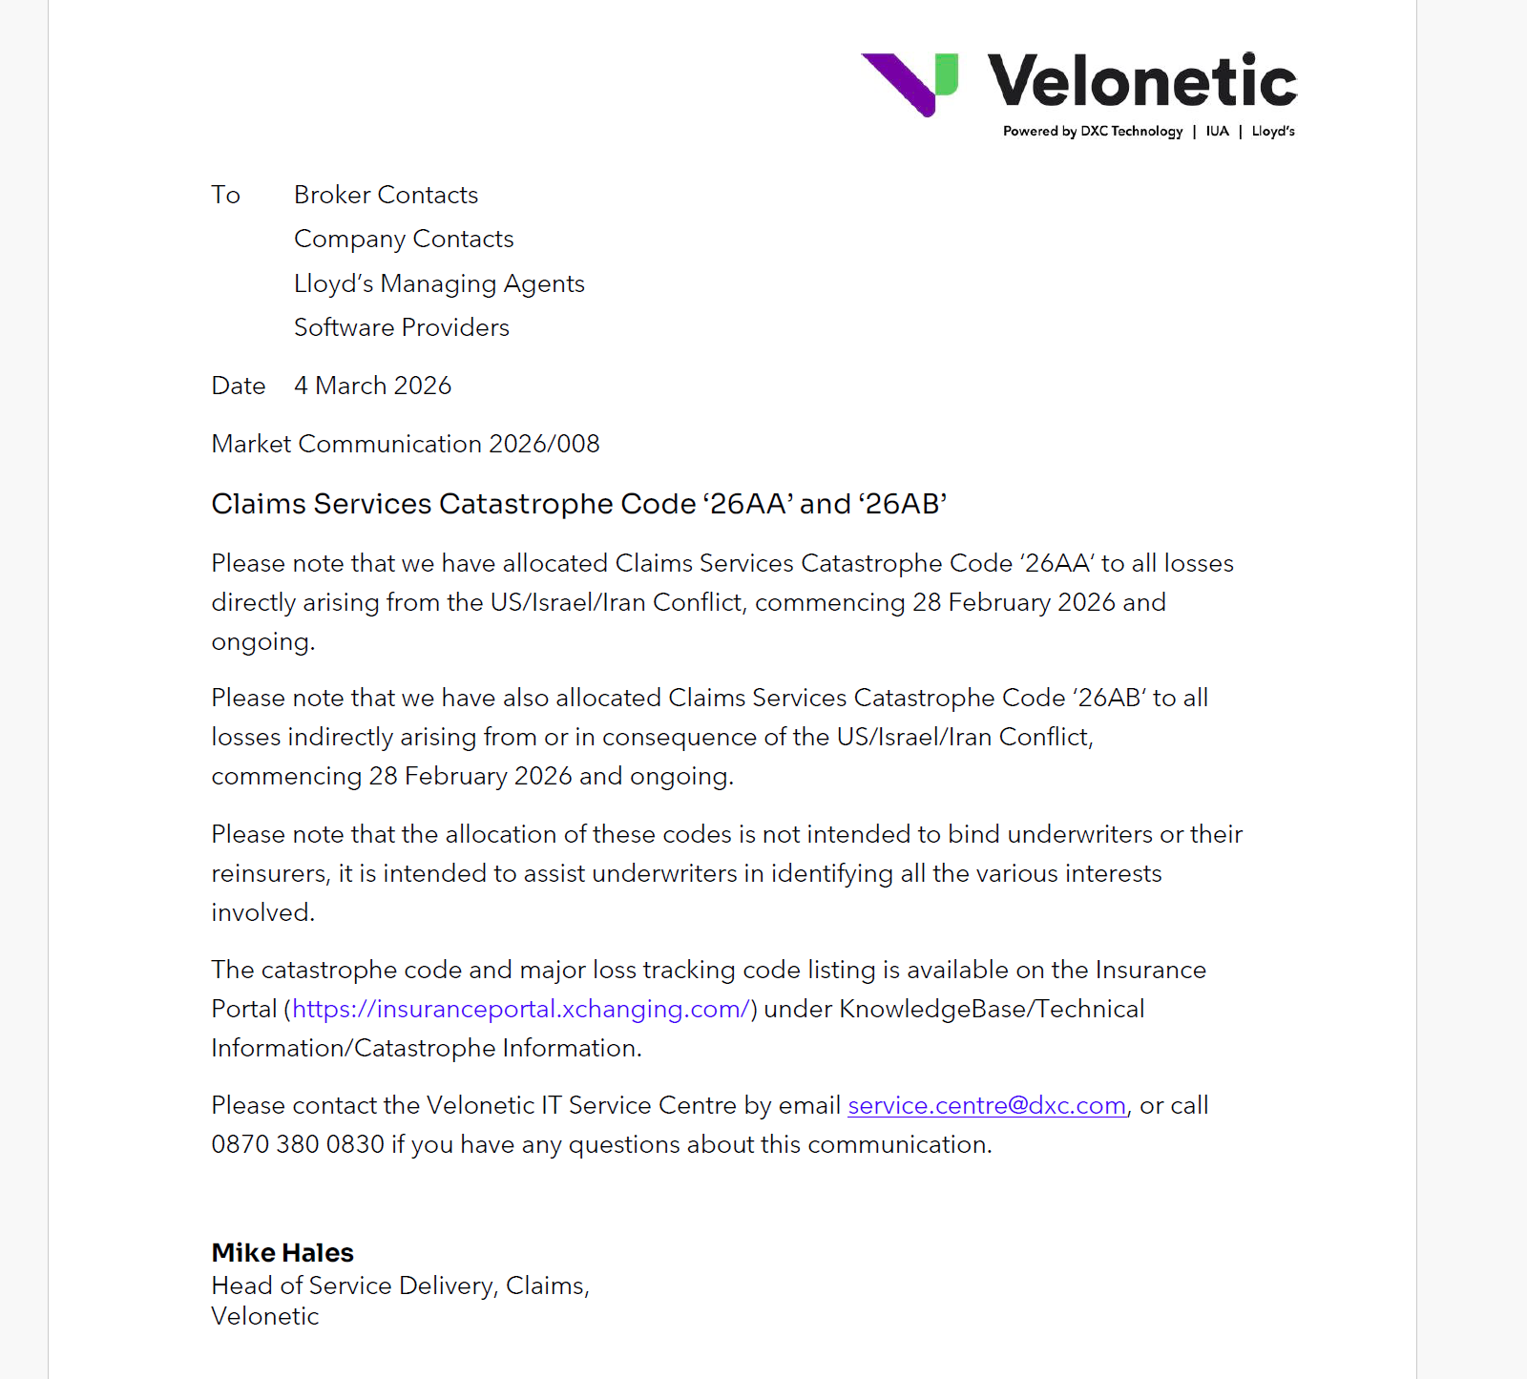
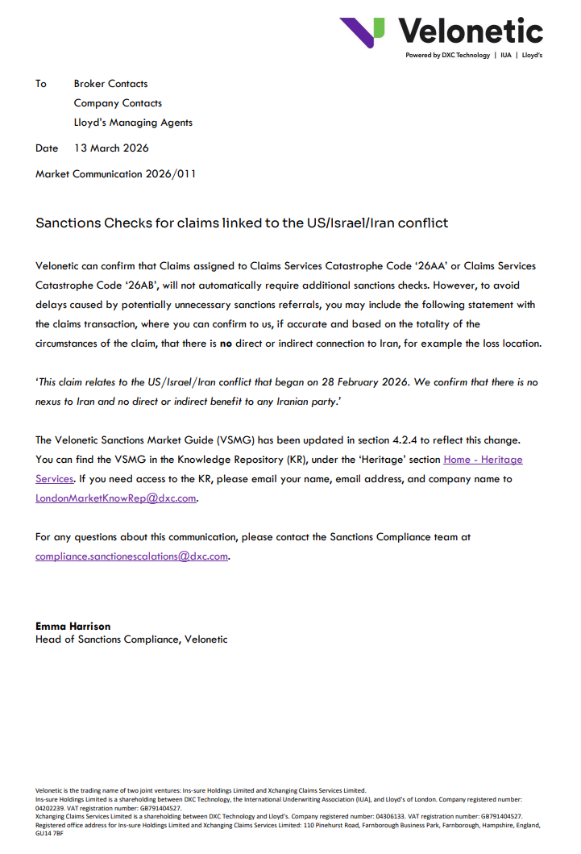
Velonetic issues CAT Code
Velonetic issues clarification on sanctions checks

