Slide 1
Vision for Delegated Claims
Facilitating a better future
Delegated Authority Claims Management Group (DACMG)

Slide 2
DRAFT
Introduction
Delegated authority business is a cornerstone of the Lloyd’s Market, with Managing Agents relying extensively on Delegated Claims Administrators (“DCAs”)* to deliver the claims service and uphold the overall client and customer proposition.
As this distribution channel develops and Lloyd’s strengthens its expectations around oversight, the effectiveness of these partnerships and delegated claims operations has never been more critical.
However, the delegated claims operating model is constrained by long standing structural challenges. Scale, and a lack of coordination and standardisation have created friction across the Market, driving inefficiency, duplicative effort, and inconsistent outcomes.
Engagement with Managing Agents, DCAs, and other key stakeholders consistently highlights these issues, reinforcing the need for a more coherent and sustainable approach.
This presents a compelling case for the Market to focus on strategic improvements to delegated claims operations, to develop a more resilient operating model and lay the foundations for a future ready ecosystem - the benefits of which will be improved efficiency, oversight, enhanced decision‑making and profitability.
*including Coverholders with claims authority
Notes:
ANGUS

Slide 3

DRAFT
Vision
A simplified operating framework, underpinned by enabling technology, strong oversight and data‑led insights – which supports the strategic partnership between Managing Agent and DCAs to deliver an effective claims service to customers.
Focus Areas
Three strategic focus areas for the next 3 years:
Improve Data
Streamline Oversight
Cost Management
Notes:
ANGUS

Slide 4
DRAFT
Principles for delivering a
Delegated Claims Strategy
Act collectively as a Market
The delegated claims model is highly interconnected, and sustainable improvement can only be achieved if MAs and DCAs act collectively, recognising the reciprocal relationships and shared outcomes.
Engage early and continuously
Meaningful engagement and consultation with MAs, DCAs, and key stakeholders will be embedded from the outset and throughout delivery. Solutions will be shaped with the Market, not imposed on it.
Design for adoption, not just delivery
We will prioritise solutions that are practical and scalable, that achieve broad Market buy in. Overcoming historic barriers to adoption is critical to ensuring the Market realises the full value of its investments.
Deliver clear economic value
Initiatives will be designed to deliver tangible economic benefit to the Market, supporting a more efficient and commercially sustainable delegated claims ecosystem.
Enable Leadership and accountability
We will ensure leaders are empowered to lead and are not unreasonably constrained in fulfilling their duties, while ensuring appropriate oversight and governance.
Strategic alignments
We will focus on initiatives that align with the strategic focus areas and deliver value for the Market as a whole
Notes:
ANGUS

Slide 5
DRAFT
Data
What’s the problem?
Inconsistency, low‑quality and issues accessing delegated claims data creates inefficiency and constrains effective performance management and underwriting decision‑making.
Why do we care?
Data is the single most important commodity in insurance and MAs need easy and efficient access to good clean claims data to support and manage the performance of its business.
What’s the Vision?
Market adoption of a consistent data integration, validation and distribution approach - providing all stakeholders with efficient access to good clean claims data, from which to develop insights to support decision making.
Notes:
ANGUS

Slide 6
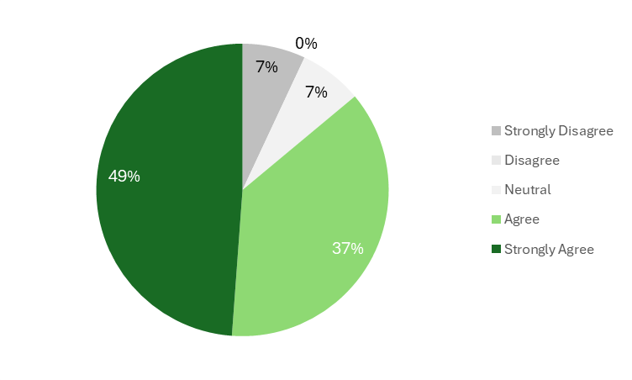
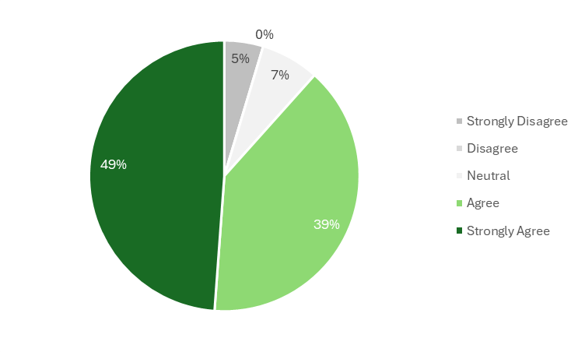

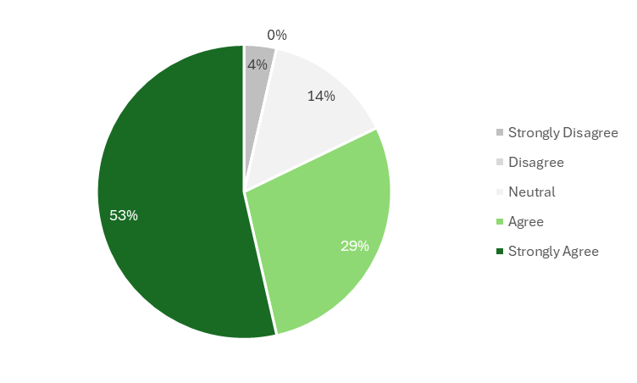
Data – to what extent do you agree with…
… PROBLEM (MAs)
… PROBLEM (DCAs)
KEY POINTS
43 MA responses
33 DCA responses
> 80% agreement across both parties
… VISION (MAs)
… VISION (DCAs)
Sources: MA Forum 12/03/2026, DCA Forum 26/03/2026

Slide 7
DRAFT
Oversight
What’s the problem?
The Delegated Claims Oversight process is inconsistent and inefficient -placing significant and unnecessary administrative burden on MAs and DCAs to carry out responsibilities.
Why do we care?
Oversight of DCAs is a fundamental duty of MAs to oversee customer outcomes, manage risk, meet regulatory obligations and protect profitability.
What’s the Vision?
A solution, which streamlines delegated claims management activities – driving a simplified, efficient and sustainable process, which supports better decision making and collaboration between MAs and DCAs
Notes:
ANGUS

Slide 8
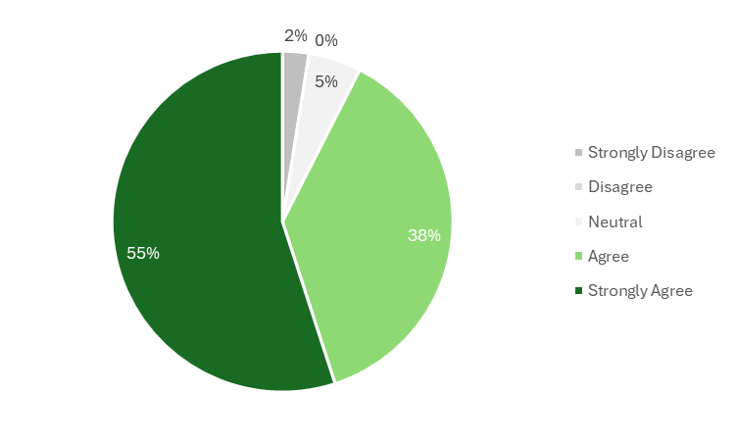
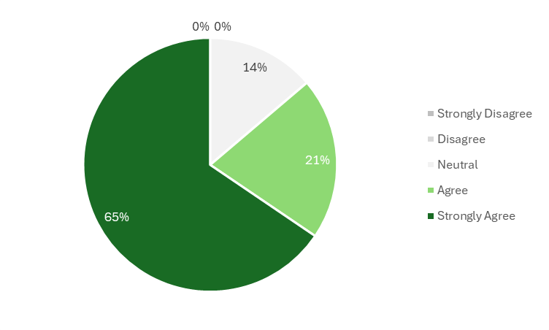
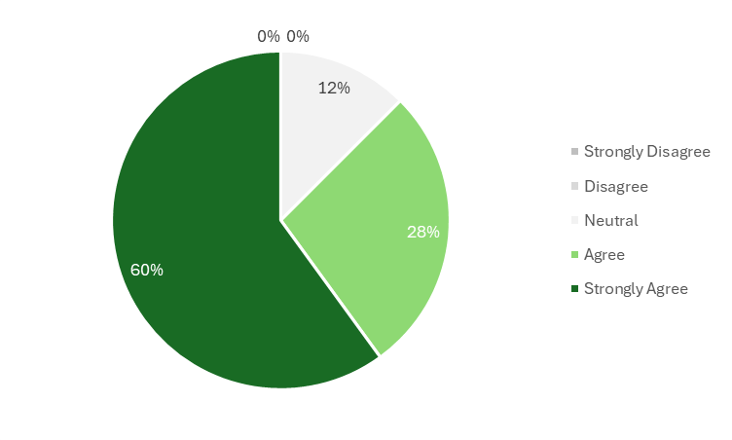

Oversight – to what extent do you agree with…
… PROBLEM (MAs)
… PROBLEM (DCAs)
KEY POINTS
43 MA responses
33 DCA responses
> 85% agreement across both parties
… VISION (MAs)
… VISION (DCAs)
Sources: MA Forum 12/03/2026, DCA Forum 26/03/2026

Slide 9
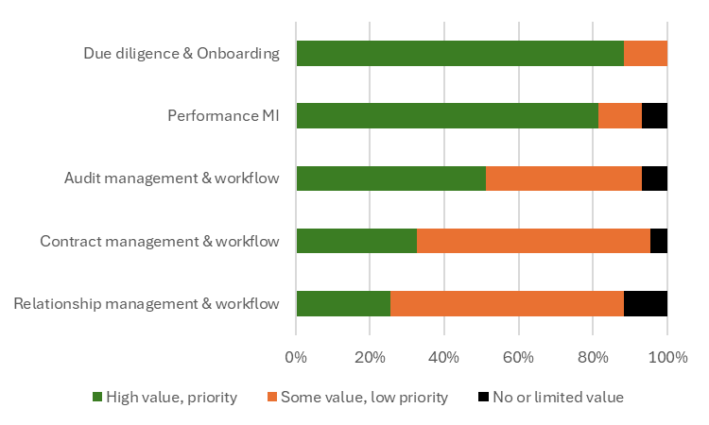
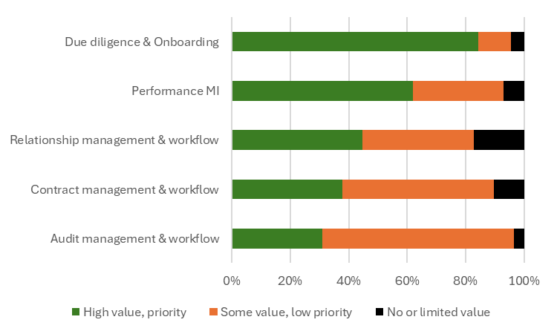
Oversight – where do you place value in a market technology solution?
MANAGING AGENTS
DCAs
Sources: MA Forum 12/03/2026, DCA Forum 26/03/2026

Slide 10
DRAFT
Cost Management
What’s the opportunity?
There are opportunities to better understand and manage the costs associated with delegated claims management.
Why do we care?
Maximising opportunities to manage cost associated with delegated claims management contributes to supporting sustainable profitability.
What’s the Vision?
A transparent cost model, supported by technology and/or services, which helps to identify and realise cost management opportunities.
Notes:
ANGUS

Slide 11
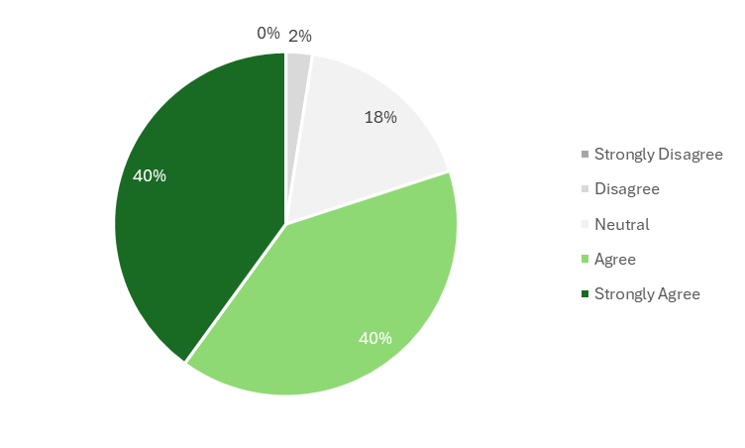
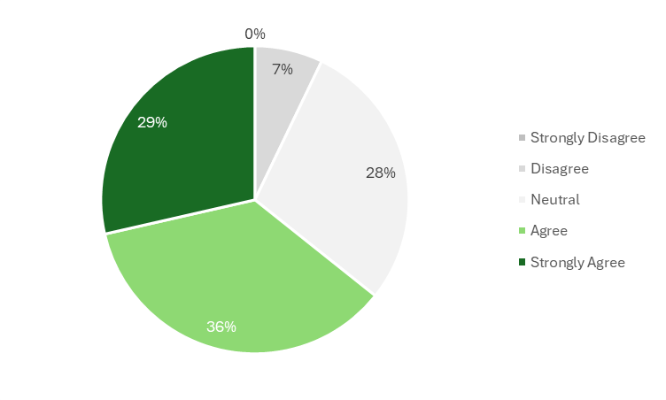
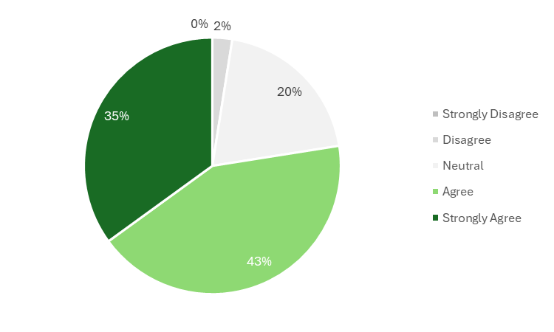
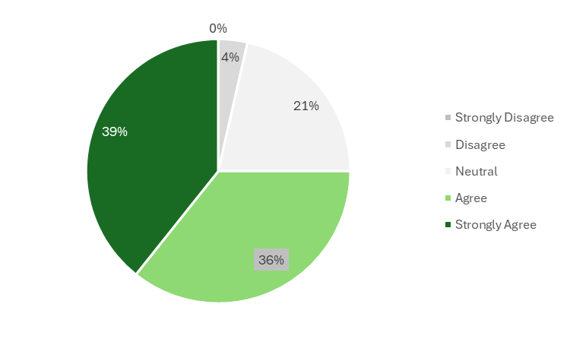
Cost Management – to what extent do you agree with…
… OPPORTUNITY (MAs)
… OPPORTUNITY (DCAs)
KEY POINTS
43 MA responses
33 DCA responses
Some divergence between MAs and DCAs
MAs 80% and 78% agreement
DCAs 65% and 75% agreement
Increased neutrality rather than disagreement
… VISION (MAs)
… VISION (DCAs)
Sources: MA Forum 12/03/2026, DCA Forum 26/03/2026

Slide 12
Next Steps
Validation & prioritisation exercise with LMACC – April 2026
Formation of working groups
  Problem statements, solution options, business cases, resource requirements
  Planning for 2026 and beyond
Continued engagement with market and its partners

